Slide 1
Conferences,
Conventions, and Hacking, oh my!
Alex Malm

Slide 2
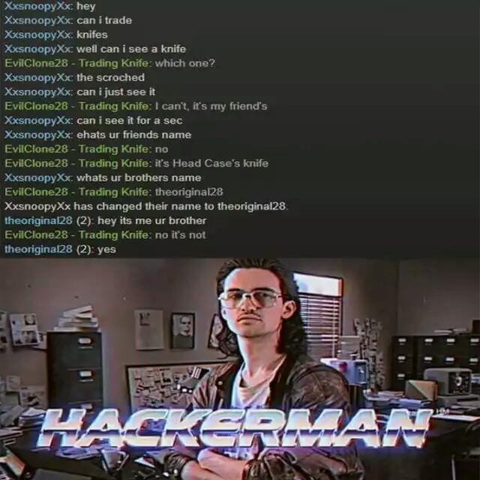
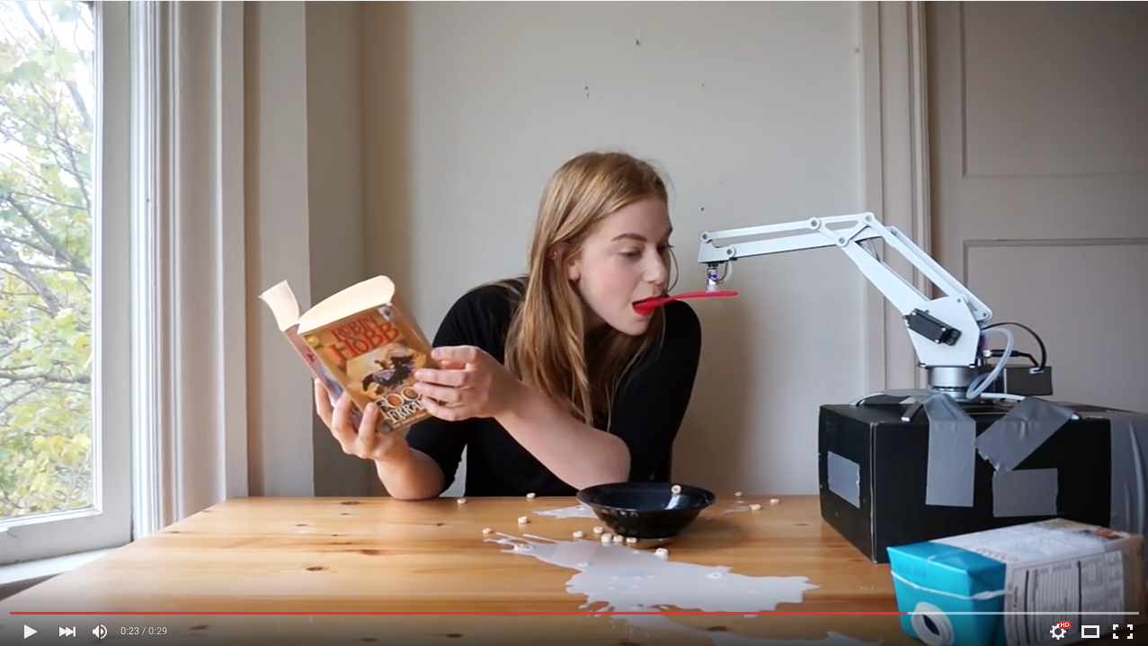
What is your idea of a computer “person”?

Slide 3


What is your idea of a computer “person”?
Society’s View:
Socially awkward
Lone wolf
Video games
ENHANCE!
Reality:
Tinkering
Learning
Passion for technology
FUN!

Slide 4

What got you interested in computers?

Slide 5

Do you want to make money from this field?

Slide 6
Do you want to make money from this field?
Of course!!!
But... how?

Slide 7

How do you learn best?

Slide 8


How do I network?

Slide 9
GET YOURSELF OUT THERE
How do I network?

Slide 10
Where is “there”?

Slide 11
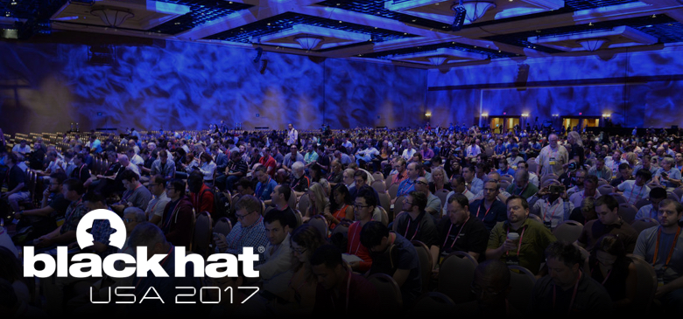
CONS!!

Slide 12
But.. where are these cons?
hope.net
securitybsides.com
brrcon.com
rsaconference.com
carolinacon.org
THEY’RE FREAKIN EVERYWHERE!

Slide 13

Ok... but when do I go?
Right Meow!

Slide 14
What’s so great about these anyway?
Ability to learn (from the best)
Ability to connect with others (Time is $$, Conversation, hey maybe make some friends too)
Ability to Network (Get yourself out there!)
Ability to show off skills ( Participate! )
HAVE FUN (Big)
Well I’ll tell ya!

Slide 15

What’s so great about these anyway?
The professionals!

Slide 16
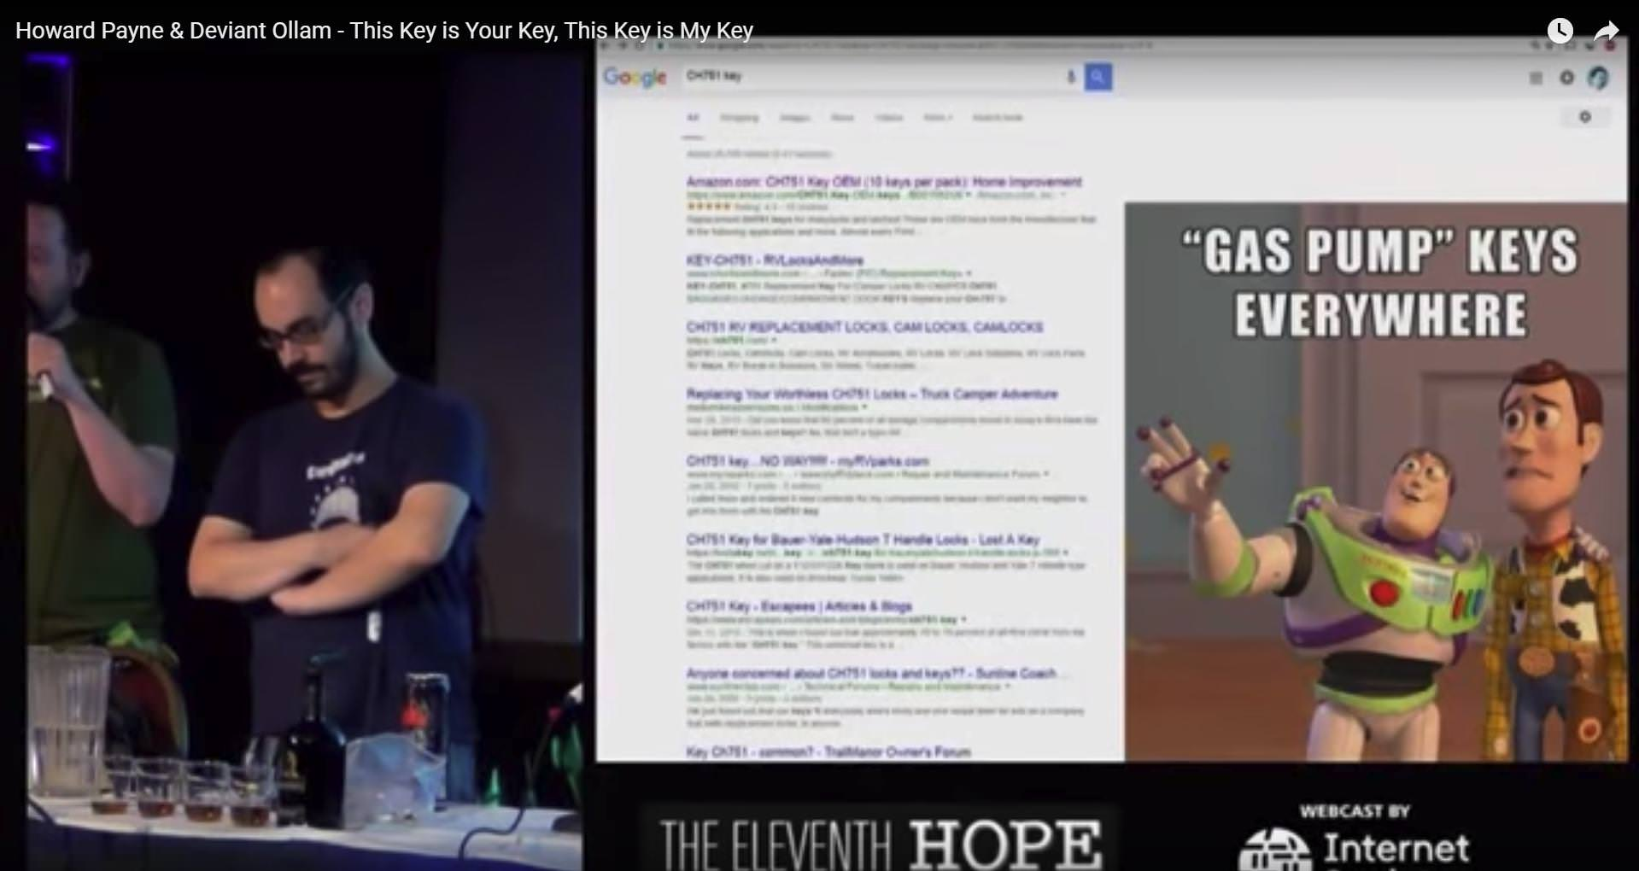

Slide 17
What’s so great about these anyway?
We as humans are social creatures, getting together gives us the ability to connect with people that have similar interests, share our ideas, and get ideas from others. This is what we as a species are built for! Broaden your horizons, find a way to contribute to humanity, even if only one person is affected, you have done your job.
The Human Element!

Slide 18
The end!

